Slide 1
An Analysis OF
2020 US POVERTY RATES
BY COUNTY
Carolyn Fiore .
Shruti Biradar .
Kevin Russell

Slide 2
AGENDA
SUMMARY
METHODS
RESULTS
DISCUSSION
REFERENCES

Slide 3
“If a free society cannot help the many who are poor, it cannot save the few who are rich.”
—John F. Kennedy¹

Slide 4
summary

Slide 5
summary
The 2020 official U.S. poverty rate in was 37.2 million, 11.4% of population²
8.6% of Americans did not have any health insurance for the entire year, despite the onset of the COVID-19 pandemic²
Federal Minimum Wage initiated at $0.20 on October 24, 1938. In the 83 years since then, it has been increased 23 times, currently at $7.25.³
21 states currently maintain the federal minimum wage. Five states currently have no minimum wage laws, and 2 (Georgia and Wyoming) have state minimum wage lower than the federal requirement ($5.15/hr).⁴

Slide 6
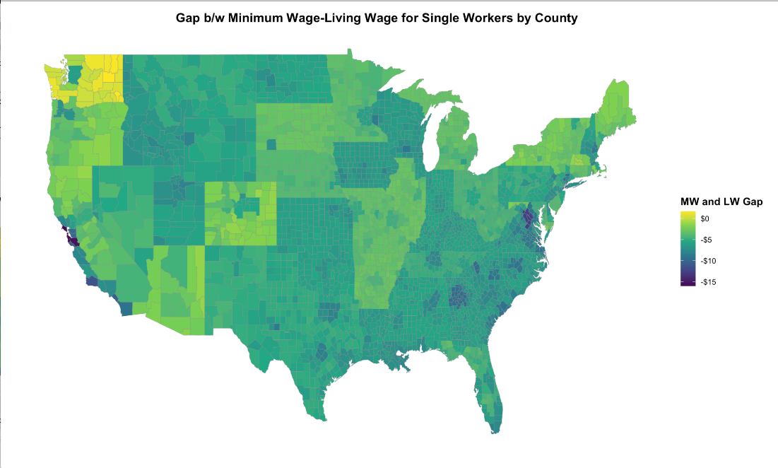
summary

Slide 7
Goals
Explore the demographics of American poverty and find variables that are correlated with the poverty rate
Create a classification model to identify predictors for poverty rate (dependent variable: pov_pct)
Data based on family unit of 1 adult, 0 children

Slide 8
data sets
Poverty Status In The Past 12 Months By Sex By Age, 2020 (U.S. Census) [1] ⁵
MIT Living Wage Calculator Data, 2020 (Dr. Amy Glasmeier, MIT) [2] ⁶
State Minimum Wage Data, 2020 (Bureau of Labor Statistics – BLS) [3] ⁷
Local Area Unemployment, 2020 (BLS) [4] ⁸
Gross Domestic Product, 2020 (Bureau of Economic Analysis – BEA) [4] ^{9,10}
Consumer Price Index, 2020 (BLS) [5] ¹¹
Current State Government Trifectas (Ballotpedia) ¹²

Slide 9
methods

Slide 10
collecting and tidying data
[1] Poverty Status Dataset: all 8 dataset CSVs imported, tidied, and joined – mutations required to calculate desired variables such as percentage of population demographics and county poverty percentage
[2] Living Wage Dataset: imported, mutation required to add State Minimum Wage Dataset [3] and calculate Minimum Wage/Living Wage gap
[4] GDP Dataset consisted of 4 separate datasets which required significant research into documentation, tidying, and joining to create one dataset
[5] CPI Dataset: most difficult dataset to tidy and join. Required significant research into documentation and county conversion
[6] State Government Dataset: created based on 2020 election results
Once imported, all datasets underwent additional tidying, mutation to group by FIPS code (counties), NA values removed, and data validated before EDA.
Notes:
** pov_pct issues with 0/0

Slide 11
creation of new variables
County MW/LW Gap
Missing values imputed (3 counties / 3,173 counties)
For each county:
County Living Wage (1 Adult, 0 Children) [2] – State Minimum Wage [3]
Ranged from $16/hour gap to $1/hour surplus (WA)
County Poverty Percentage
For each county:
(sum: # of people living below poverty line, all ethnicities) / (sum: total population of county, all ethnicities)
Ranged from 0% to 59.32%, with the density between 10-23%
Ethnicity Poverty Percentage
For each county, for each of 8 ethnicities:
Count of XX Ethnicity in county living below poverty line / total population of XX Ethnicity in county
Gender Poverty Percentage
For each county, for respondents categorized Male and Female:
Count of (Fe)Males in county living below poverty line / (total sum of people in county living below poverty line)
Government Control
Whether a state government is fully controlled (all three branches) by one party

Slide 12
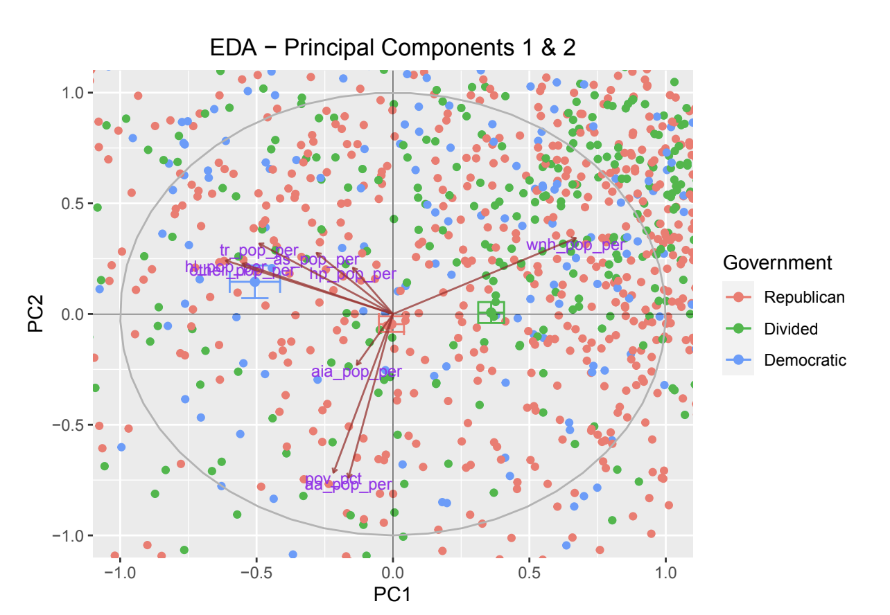
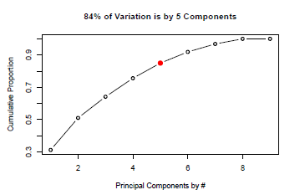
EDA
PCA Results
Scree Plot
Notes:
scree plot—80% variation from 2 allows us to reduce from 73 candidate predictors in this model to 2; and EDA shows 14 CPI measurements that potentially correlate to impoverished

Slide 13
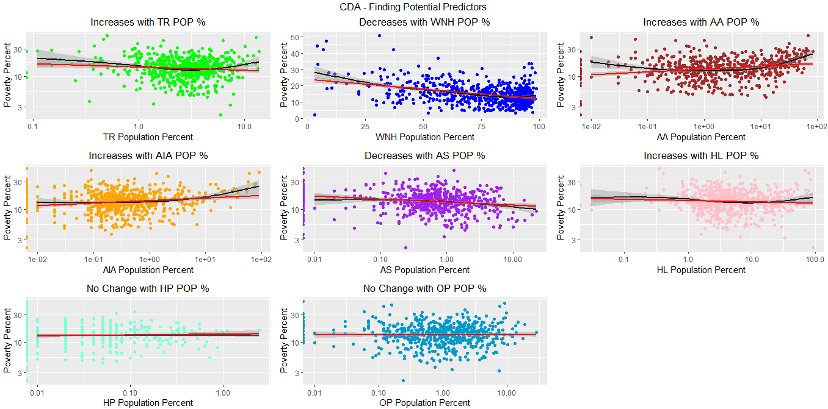
candidate predictors

Slide 14
chosen predictors
Demographics (Percent of Population)
“American Indian/Alaskan”
“White Hispanic/Latino”
“African American”
“Two or More Races”
MW/LW Gap
CPI
Communication Commodities
Household Furnishings And Supplies
Other Personal Services
Education
Transportation
Medical Care
Null Hypothesis: None of the variables included in the model (see left) will influence the classification of counties as “Impoverished.”
Alternative Hypothesis: one or more of these measurements do influence the classifying of Impoverished.
α = 0.01

Slide 15
results

Slide 16
model fitting
Logistic Regression
The fitting for logistic regression did not converge, suggesting that there are predictor variable(s) that perfectly separate the dependent variable.
Penalized regression implemented to filter noise
Lasso Regression
Lasso Regression extracted MW/LW gap, cty_pop, unemployed, ue_rate, GDP, CPI_Dairy_And_Related_Products, CPI_Education_And_Communication_Commodities, CPI_Education_And_Communication_Services, CPI_Electricity, CPI_Gasoline_Unleaded_Regular, CPI_New_Vehicles, CPI_Other_Personal_Services, CPIUtility(Piped)_Gas_Service, and gov_party_id as selected predictors.

Slide 17
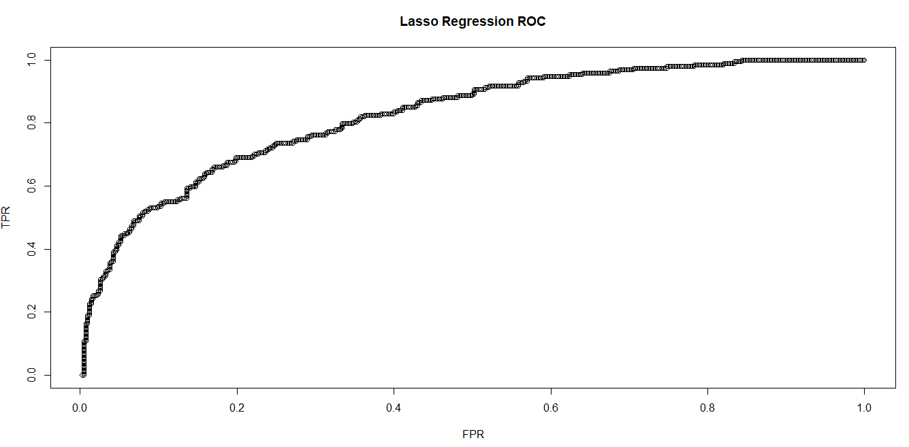
Lasso regression

Slide 18
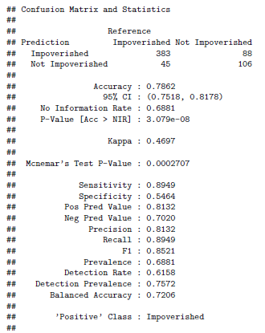
confusion matrix - Lasso

Slide 19
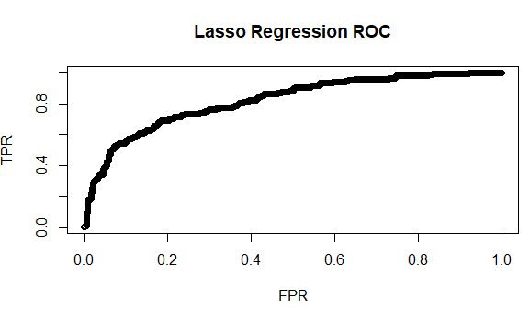
elastic net regression – ridge and lasso

Slide 20
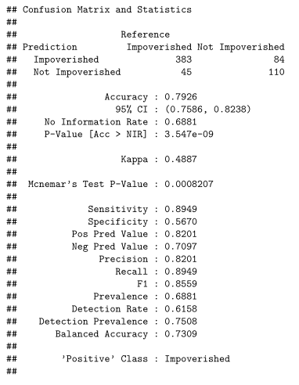
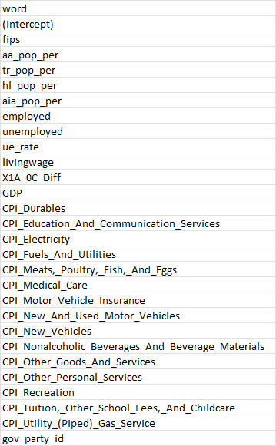
confusion matrix – elastic net

Slide 21
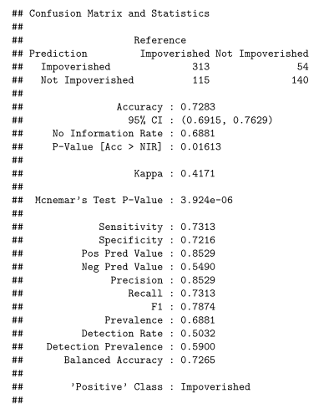
Support vector machine

Slide 22
discussion

Slide 23
summary
Predictors in model based on population data and consumer data
Higher minority composition in a county does correlate to higher poverty
Consumer metrics correlated with poverty are primarily necessities
These results can be used to target financial aid policies and social programs, ideally decreasing poverty nationwide
Although clearly not a blanket solution, legislating an increase of the minimum wage to be at least the living wage would relieve a significant amount of financial pressure

Slide 24
limitations
Missing Data
Insufficient Data:
Alaska
Hawaii
Puerto Rico
Living Wage Data:
Okaloosa County, FL
St. Martin’s Parish, LA
Currituck County, NC
Data does not include any information on use of social programs (i.e. WIC, SNAP, unemployment benefits, COVID-19 stimulation checks, etc.)
Unclear whether data captures homeless population

Slide 25
future work
Family size
Age and gender data
Dominant industry in each county
Inclusion of welfare program/benefit use
Predictive model

Slide 26
references

Slide 27
References
Kennedy, J. F. (1963). Inaugural Address. Library of Congress. [Online]. Available: https://www.loc.gov/static/programs/national-recording-preservation-board/documents/JFK_essay.pdf [accessed 7 April, 2022].
U.S. Census Bureau. (2021). “Income, Poverty and Health Insurance Coverage in the United States: 2020”. Publication: 14 September, 2021. [Online]. Available: https://www.census.gov/newsroom/press-releases/2021/income-poverty-health-insurance-coverage.html#:~:text=The%20official%20poverty%20rate%20in,million%20more%20than%20in%202019 [accessed 17 March, 2022].
US Department of Labor. (n.d.). “History of Federal Minimum Wage Rates Under the Fair Labor Standards Act, 1938 - 2009”. Wage and Hour Division. [Online]. Available: https://www.dol.gov/agencies/whd/minimum-wage/history/chart [accessed 24 March, 2022].
US Department of Labor. (2021). “State Minimum Wage Laws”. Wage and Hour Division. [Online]. Available: https://www.dol.gov/agencies/whd/minimum-wage/state. [accessed March 12, 2021].
American Community Survey, U.S. Census Bureau. “Poverty Status In The Past 12 Months By Sex By Age”. Publication: 2020. [Online]. Multiple datasets disaggregated by race/ethnicity available: https://data.census.gov/cedsci/table?q=United%20States&t= Income%20and%20Poverty%3ARace%20and%20Ethnicity&g=0100000US,%240500000&y=2020&tid=ACSDT5Y2020.B17001B [accessed 22 March, 2022].
Glasmeier, A. K., Department of Urban Studies and Planning, Massachusetts Institute of Technology. “MIT Living Wage Calculator.” [Online] Available: https://livingwage.mit.edu/ [accessed 26 February, 2022].
Department of Labor. “Changes in Basic Minimum Wages in Non-Farm Employment Under State Law: Selected Years 1968 to 2021”. [Online]. Available: https://www.dol.gov/agencies/whd/state/minimum-wage/history [accessed 27 February, 2022].
Bureau of Labor Statistics. “Local Area Unemployment Statistics”. Publication: 2 March, 2022. [Online]. Available: https://www.bls.gov/lau/laucnty20.xlsx [accessed 25 March, 2022].
Bureau of Economic Analysis. “2020 GDP Dataset”. [Online, three files]. Available: https://download.bls.gov/pub/time.series/cu/cu.series, https://download.bls.gov/pub/time.series/cu/cu.data.0.Current, https://download.bls.gov/pub/time.series/cu/cu.item [accessed 23 March, 2022].
Bureau of Economic Analysis. “Real Gross Domestic Product, by County, 2017-2020.” [Online]. Available: https://www.bea.gov/sites/default/files/2021-12/lagdp1221.xlsx [accessed 21 March, 2022].
Bureau of Labor Statistics. “Average Price Data – Consumer Price Index (CPI).” [Online]. Available: https://www.bls.gov/cpi/tables/supplemental-files/home.htm [accessed 13 March, 2022].
Ballotpedia. “Current State Government Trifectas”. [Online]. Available: https://ballotpedia.org/Gubernatorial_and_legislative_party_control_of_state_government [accessed 23 March, 2022].

Slide 28
questions

Slide 29
References
Kennedy, J. F. (1963). Inaugural Address. Library of Congress. [Online]. Available: https://www.loc.gov/static/programs/national-recording-preservation-board/documents/JFK_essay.pdf [accessed 7 April, 2022].
U.S. Census Bureau. (2021). “Income, Poverty and Health Insurance Coverage in the United States: 2020”. Publication: 14 September, 2021. [Online]. Available: https://www.census.gov/newsroom/press-releases/2021/income-poverty-health-insurance-coverage.html#:~:text=The%20official%20poverty%20rate%20in,million%20more%20than%20in%202019 [accessed 17 March, 2022].
US Department of Labor. (n.d.). “History of Federal Minimum Wage Rates Under the Fair Labor Standards Act, 1938 - 2009”. Wage and Hour Division. [Online]. Available: https://www.dol.gov/agencies/whd/minimum-wage/history/chart [accessed 24 March, 2022].
US Department of Labor. (2021). “State Minimum Wage Laws”. Wage and Hour Division. [Online]. Available: https://www.dol.gov/agencies/whd/minimum-wage/state. [accessed March 12, 2021].

Slide 30
References (cont’d)
American Community Survey, U.S. Census Bureau. “Poverty Status In The Past 12 Months By Sex By Age”. Publication: 2020. [Online]. Multiple datasets disaggregated by race/ethnicity available: https://data.census.gov/cedsci/table?q=United%20States&t= Income%20and%20Poverty%3ARace%20and%20Ethnicity&g=0100000US,%240500000&y=2020&tid=ACSDT5Y2020.B17001B [accessed 22 March, 2022].
Glasmeier, A. K., Department of Urban Studies and Planning, Massachusetts Institute of Technology. “MIT Living Wage Calculator.” [Online] Available: https://livingwage.mit.edu/ [accessed 26 February, 2022].
Department of Labor. “Changes in Basic Minimum Wages in Non-Farm Employment Under State Law: Selected Years 1968 to 2021”. [Online]. Available: https://www.dol.gov/agencies/whd/state/minimum-wage/history [accessed 27 February, 2022].
Bureau of Labor Statistics. “Local Area Unemployment Statistics”. Publication: 2 March, 2022. [Online]. Available: https://www.bls.gov/lau/laucnty20.xlsx [accessed 25 March, 2022].

Slide 31
References (cont’d)
Bureau of Economic Analysis. “2020 GDP Dataset”. [Online, three files]. Available: https://download.bls.gov/pub/time.series/cu/cu.series, https://download.bls.gov/pub/time.series/cu/cu.data.0.Current, https://download.bls.gov/pub/time.series/cu/cu.item [accessed 23 March, 2022].
Bureau of Economic Analysis. “Real Gross Domestic Product, by County, 2017-2020.” [Online]. Available: https://www.bea.gov/sites/default/files/2021-12/lagdp1221.xlsx [accessed 21 March, 2022].
Bureau of Labor Statistics. “Average Price Data – Consumer Price Index (CPI).” [Online]. Available: https://www.bls.gov/cpi/tables/supplemental-files/home.htm [accessed 13 March, 2022].
Ballotpedia. “Current State Government Trifectas”. [Online]. Available: https://ballotpedia.org/Gubernatorial_and_legislative_party_control_of_state_government [accessed 23 March, 2022].

Slide 32
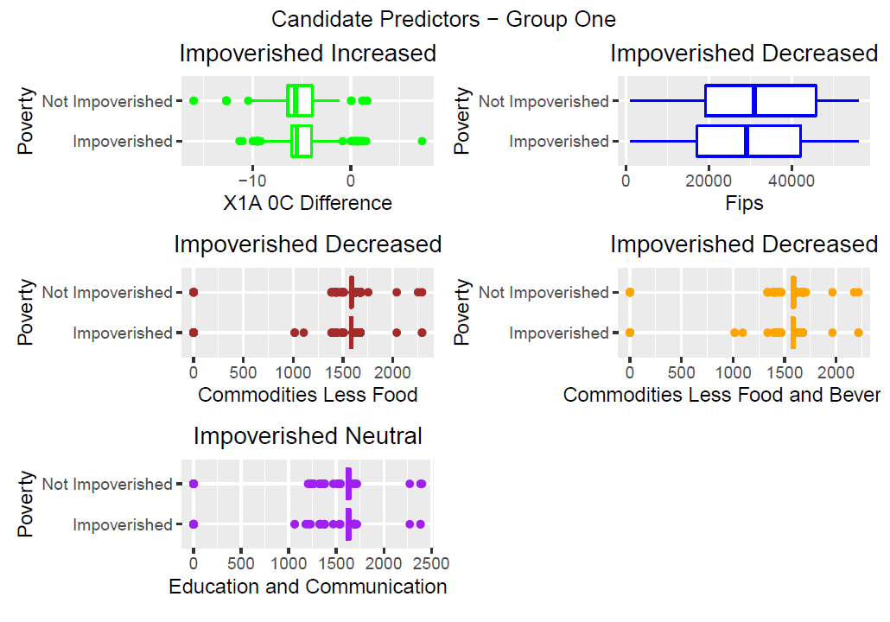
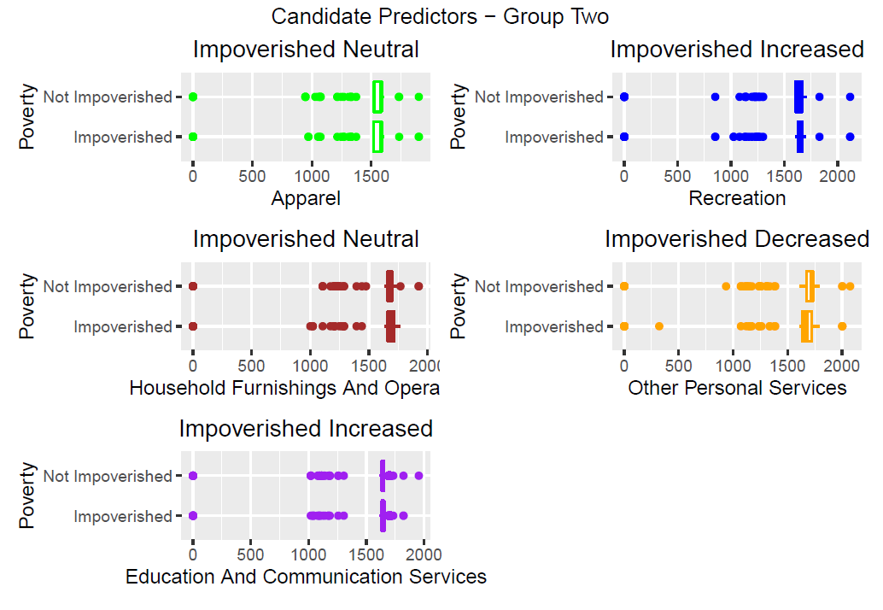
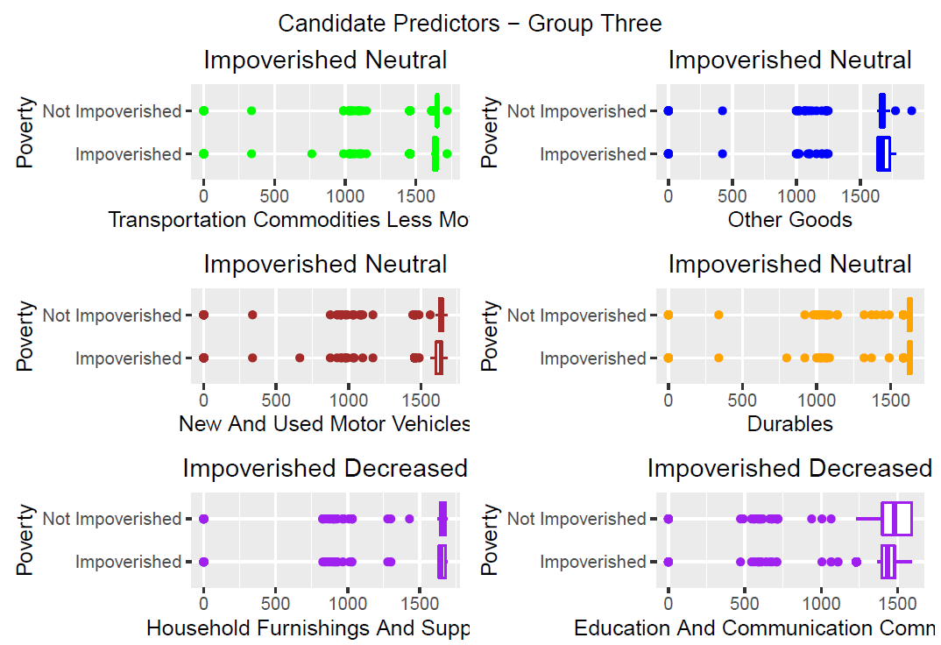
candidate predictor distributions

Slide 33
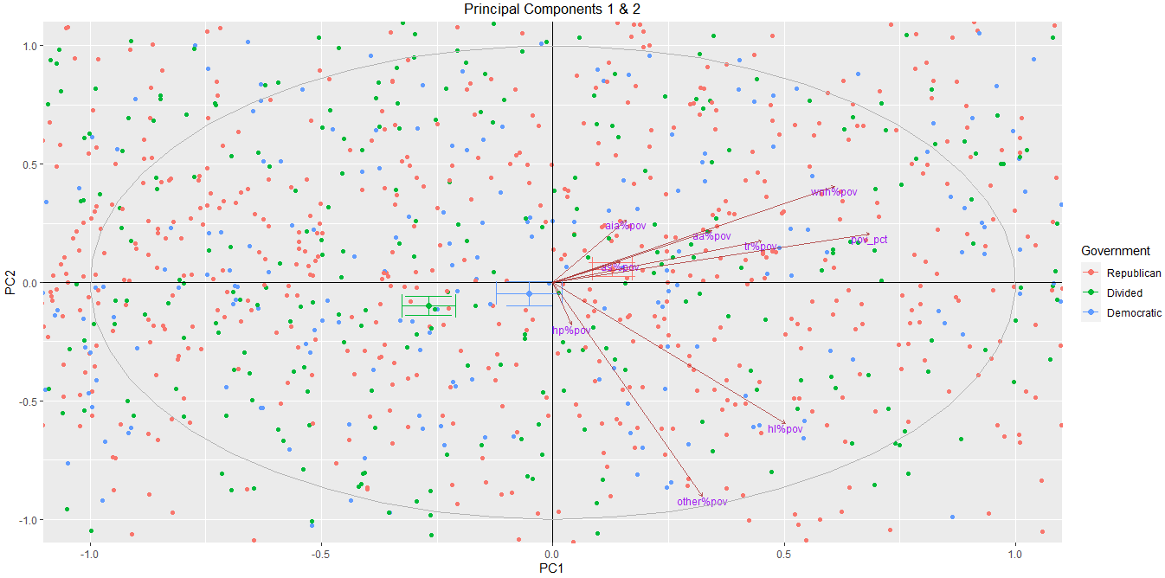
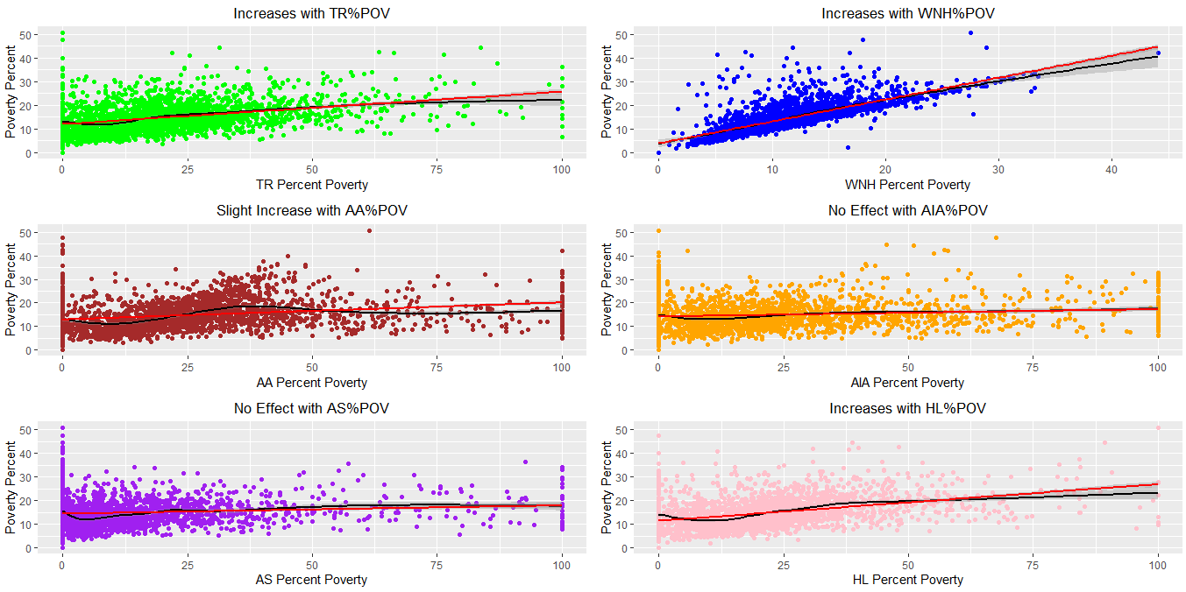
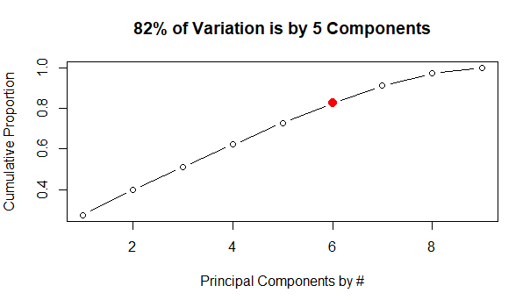
eda – round one
PCA Results
Variable Correlation to
County Poverty Percent
Scree Plot
6

Slide 34
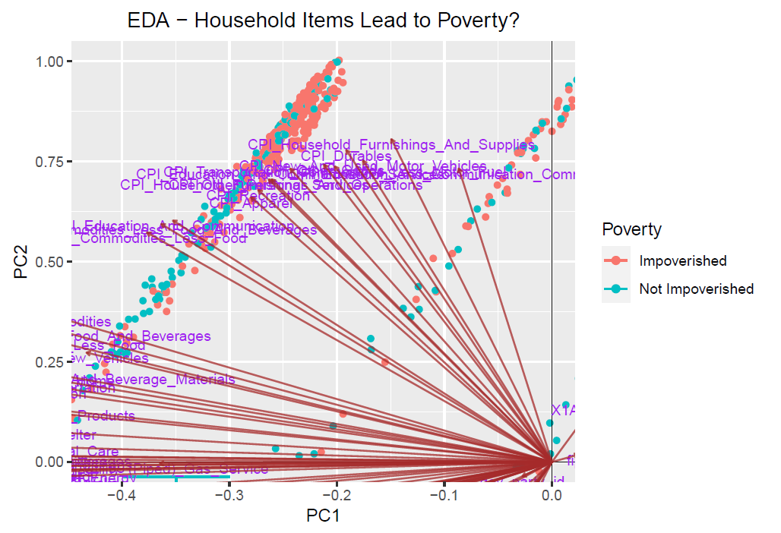
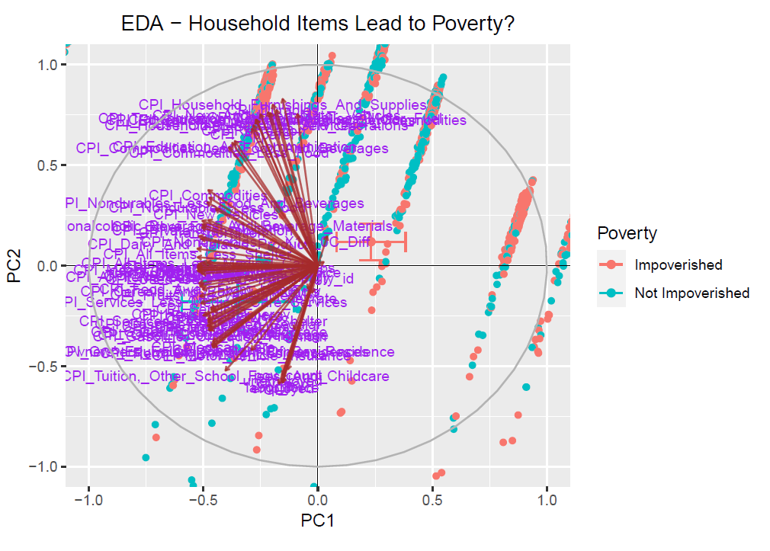
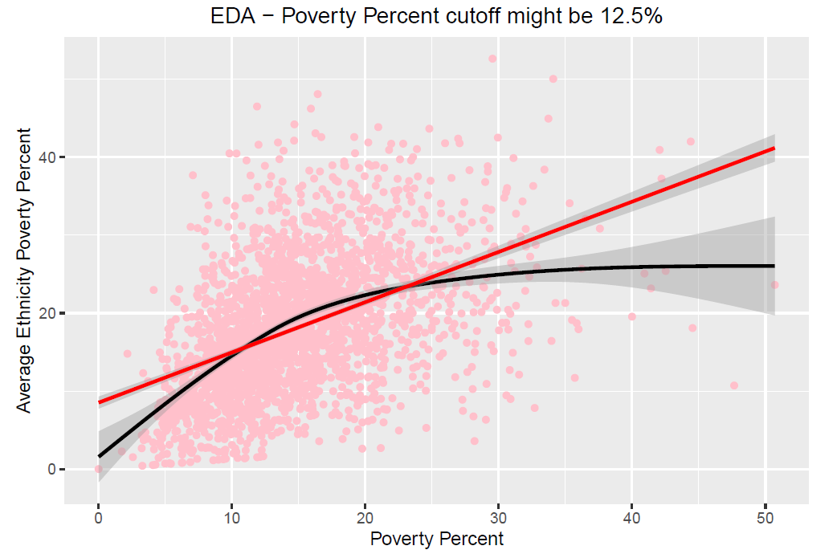
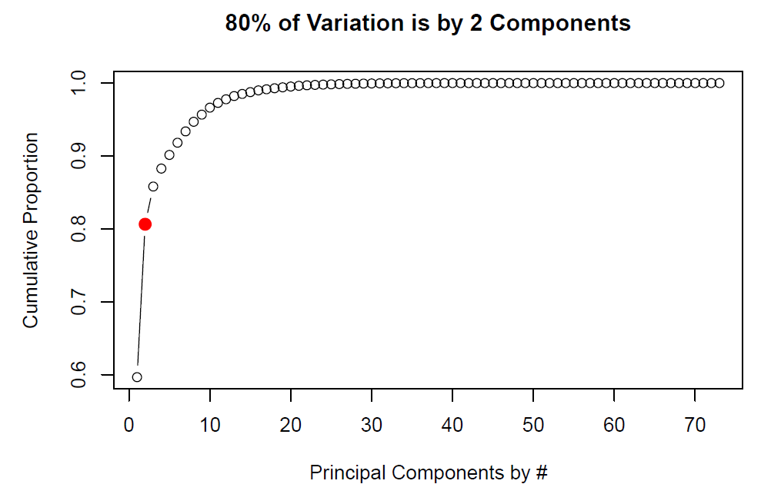
Eda – round TWO
PCA Results
Variable Correlation to
County Poverty Percent
Scree Plot

Slide 35
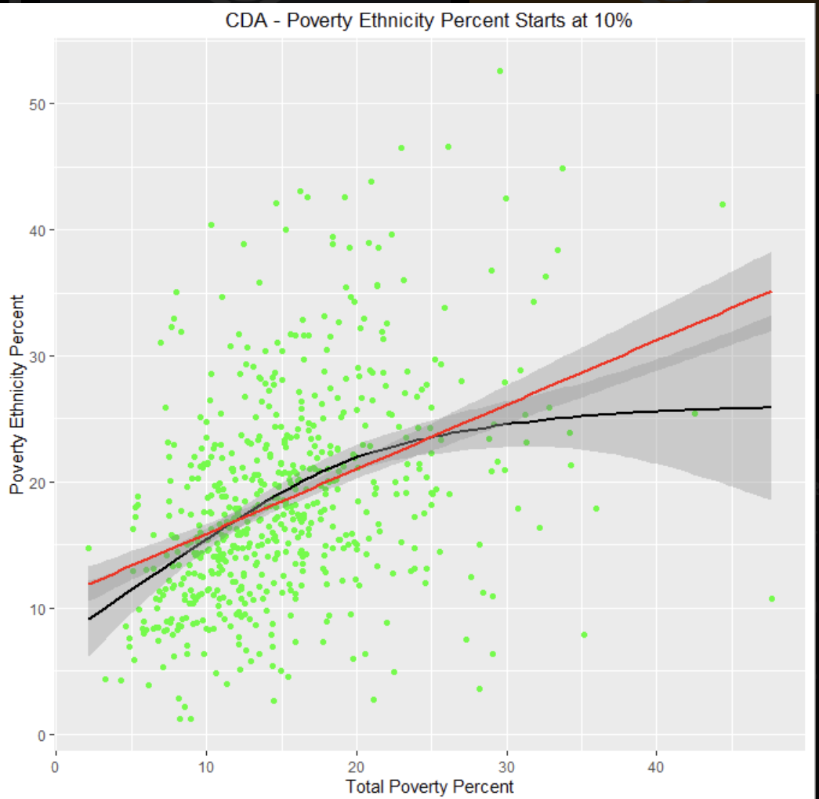
adjustments
We removed Alaska, Hawaii, and Puerto Rico from the dataset due to missing data from these states/territories
Changed cutoff to 11.4%
County distinction uses FIPS code, we kept the dataset whole rather than splitting into states
Split 80/20 for Train/Test

